Slide 1
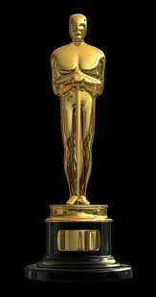
Oscar statuettes.
Author: Judyta Werno
Witold Pilecki Primary School
in Rekusy

Slide 2
OSCAR
Weight | 3.8 kilograms
Size | 34, 4 cm
Place of creation | Hollywood
Year of creation | 1929

Slide 3
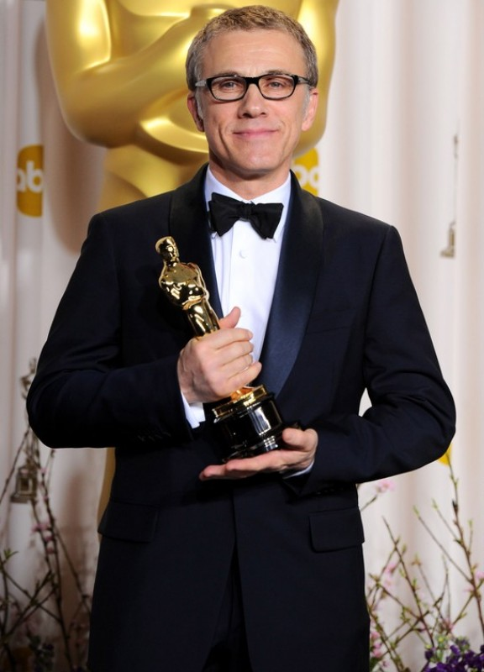
In 1944, the ceremony was broadcast for the first time outside the U.S.. At first the galas were held in late March and early April. However, since 2004, it was decided that the ceremony will be held on the last Sunday of February.

Slide 4
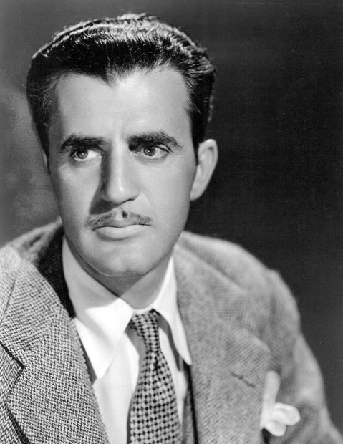
The statuette was designed by MGM art director Cedric Gibbons (who was himself nominated for it 39 times). He made a sketch of it on a napkin during one of boring banquets.

Slide 5
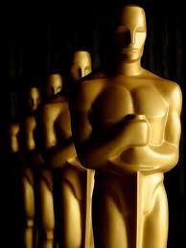
The statue shows a figure of a naked knight holding a two-handed sword downward. The knight is standing on a pedestal of a film roll, made of 5 spokes that symbolize the Academy branches: actors, directors, writers, producers and technicians. At the base there is also a shortcut A.M.P.A.S. (Academy of Motion Picture Art and Science) and the serial number of the statuette.

Slide 6
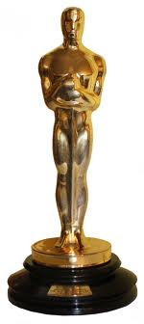
Since 1949, each statue is numbered, starting with number five hundred . The statuette cannot be sold. It can only be redeemed by the Academy for a symbolic $10, while the cost of implementation is about $300.

Slide 7
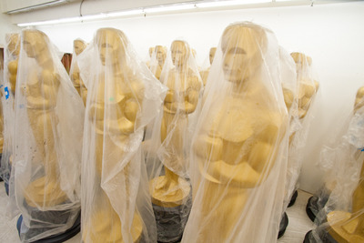
Each of 50-60 copies is created each year for 12 people. It takes them about 20 hours. A person responsible for watchingWatch over the work is for years the same . It’s R. Owens, owner of Chicago's RS Owens and Company. If there is a mistake, flawed figure is immediately fused. So far, more than 160 statues has been damaged.

Slide 8
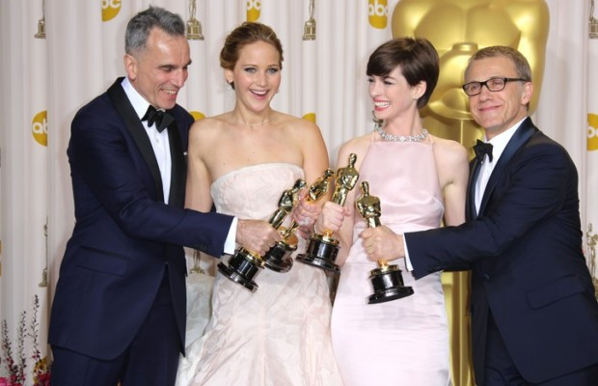
Oscar, despite its popularity, is only a statuette. The American Film Academy decides who will be awarded.

Slide 9
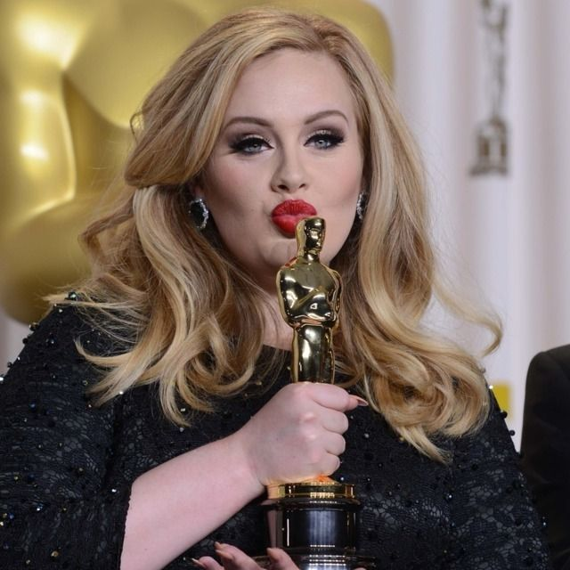
The Academy decided to abandon the traditional appearance of the Oscar statuette only twice, in order to grant a honorary awards for Edgar Bergen and Walt Disney. Bergen got a wooden copy of the statuette (reminiscent of his character creation - a wooden boy named Charlie), while Disney received seven little ‘Oscars’.

Slide 10
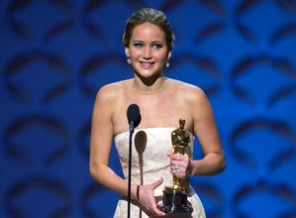
By 1931 Oscar was oficially called the Academy Award for Merit the "gold trophy," or simply "statue". One of the most interesting names – ‘Iron Man’ was used by Variety magazine. However, it stillremains a mystery, where did the name Oscar actually come from.

Slide 11
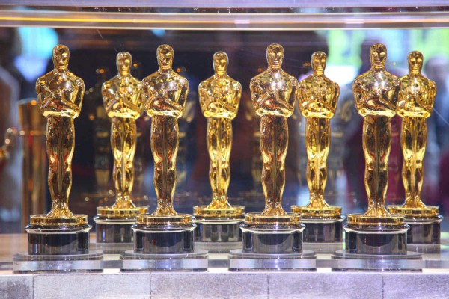
Date of the ceremony was postponed in the history of only three times - in 1938 because of the great flood in 1968 due to the funeral of Martin Luther King, and in 1981 due to the assassination attempt of Ronald Reagan.

Slide 12
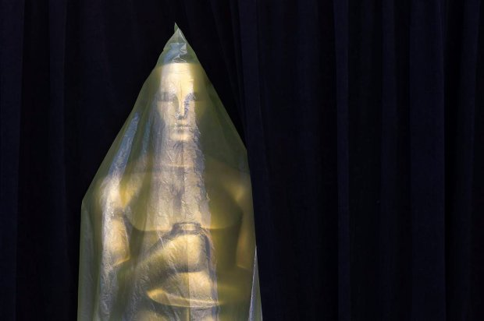
Most Oscars in the history of the competition won the "Ben Hur," "Titanic" and "Lord of the Rings: The Return of the King".
(each with 11 statues).

Slide 13
Bibliography:
http://acertaincinema.com, dostęp 01.03.2013r.
http://stopklatka.pl, dostęp 01.03.2013r.
http://www.newsfix.pl, dostęp 02.03.2013r.
http://pl.wikipedia.org, dostęp 02.03.2013r.
http://ochyachy.pl, dostęp 02.03.2013r.
http://www.rp.pl, dostęp 04.03.2013r.
http://www.e-gify.pl, dostęp 04.03.2013r.

