Slide 1
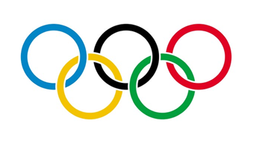

Slide 2
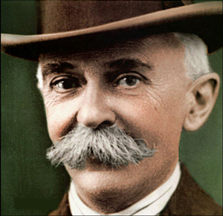
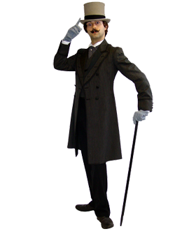
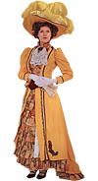
When in the 1890’s Baron Pierre de Coubertin from France proposed to resume the tradition of Olympic Games and brought his purposes, which were to bring all nations together, involve them not only physically, but also emotionally in the beauty of fair play competition and let human beings live.. he excluded women.
When In the 1890’s Baron Pierre de Coubertin from France proposed to resume the tradition of Olympic Games and introduced his objectives, which were to bring all nations together, involve them not only physically, but also emotionally in the beauty of fair play competition and joy.. he excluded women.

Slide 3
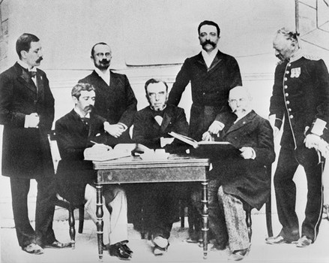
The only role of women’s
participation in the Olympics,
was rewarding men with applause.

Slide 4
‘’Olympics were NO place for women’’.
- Baron Pierre de Coubertin

Slide 5
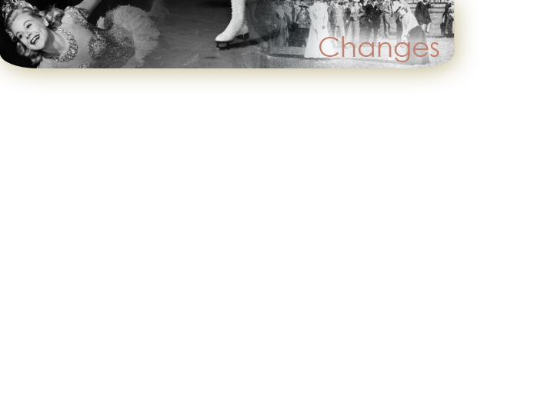
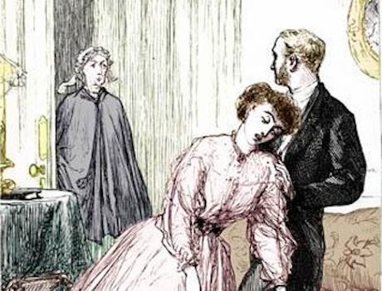
Back then, women were believed to be weak due to energy expended on reproductive functions and being way too emotional, wheras men were naturally agressive and better fitted for exercising and sports.

Slide 6
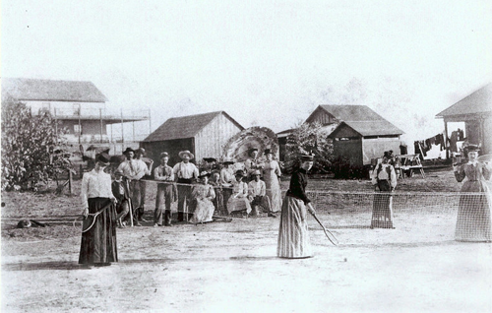
Notwithstanding, women were given a premission to participate in a few recreational sports
at the beginnig of 1900’s.

Slide 7
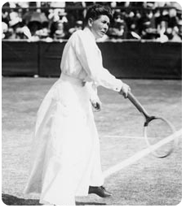
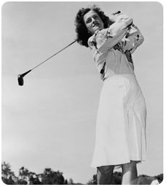
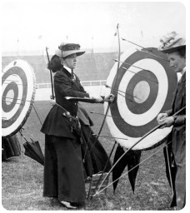
Tennis
(since 1900)
Golf
(since 1900)
Archery
(since 1904)

Slide 8
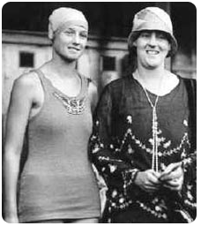
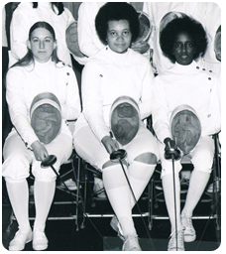
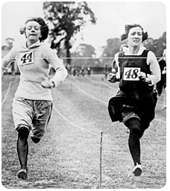
Swimming
(since 1912)
Fencing
(since 1924)
Athletics
(since 1924)

Slide 9
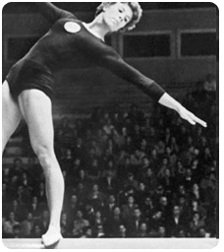
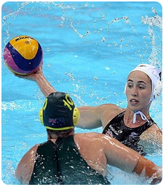
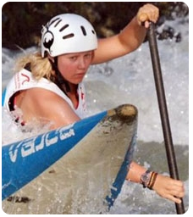
Gymnastics
(since 1928)
Polo
(since 1936)
Canoeing
(since 1948)

Slide 10
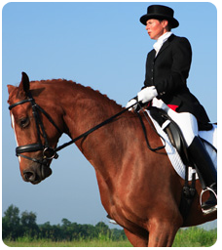
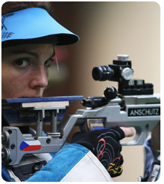
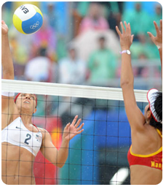
Equestrian Sports
(since 1952)
Shooting
(since 1960)
Volleyball
(since 1964)

Slide 11
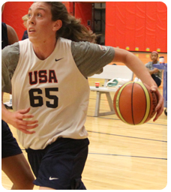
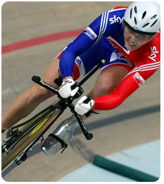
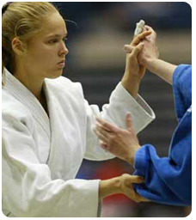
Basketball
(since 1976)
Cycling
(since 1984)
Judo
(since 1992)

Slide 12
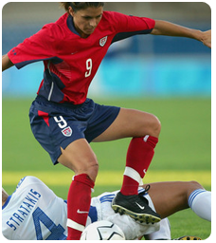
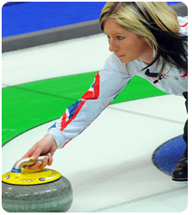
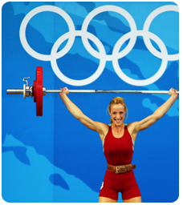
Football
(since 1996)
Curling
(since 1998)
Weightlifting
(since 2000)

Slide 13
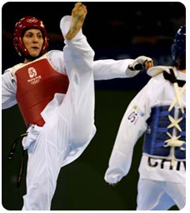
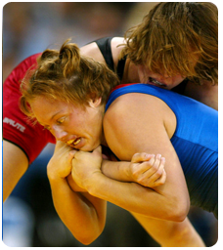
Taekwondo
(since 2000)
Wrestling
(since 2004)
Boxing
(since 2012)

Slide 14
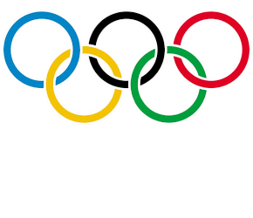
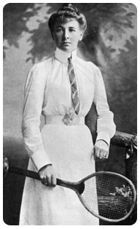
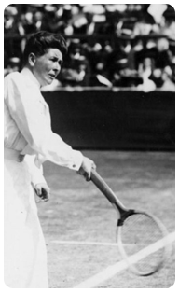
She was British tennis player and the first woman, who won Olympic Gold medal in Paris, France in 1900.

Slide 15
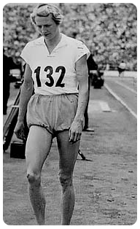
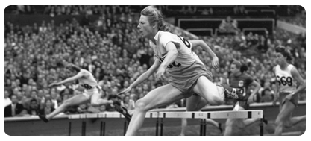
Blankers – Koen was a Dutch athlete, most – known for winning four gold medals at the 1948 Summer Olympics, London. During her succesfull career she set twelve world records, won five European titles. ‘’The Flying Housewife’’ - as audience called her – was voted "Female Athlete of the Century’’ in 1999.

Slide 16
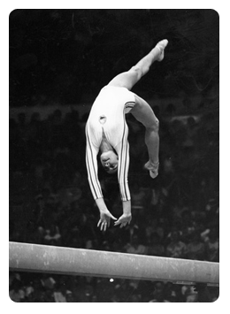
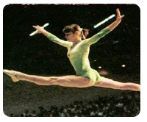
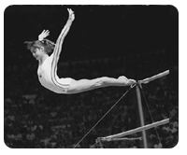
She is a Romanian gymnast, winner of three Olympic gold medals at the 1976 Olympics, Montreal. Nadia is the first female gymnast ever, who had been awarded a perfect score of 10. At the 1980 Olympics, she won two gold medals. One of the best-known gymnasts in the world.

Slide 17
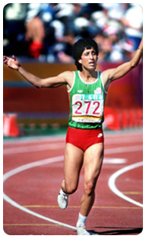
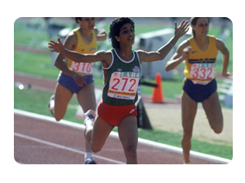
Nawal is a Moroccan hurdler, who won the inaugural women's 400 m hurdles event at the 1984 Summer Olympics, thereby becoming the first female Muslim born on the continent of Africa to become an Olympic champion.

Slide 18
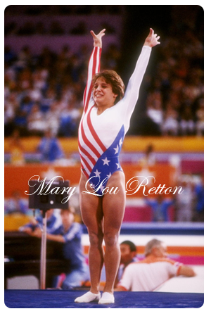
Sixteen-year-old gymnast Mary Lou Retton entered the 1984 Olympics with no major international experience. She became the first American, woman or man, to win the all-around after earning perfect 10s for the floor exercise and vault.

Slide 19
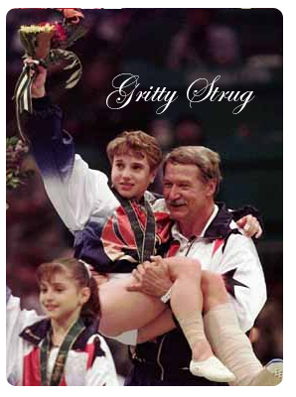
In the 1996 women's gymnastics team competition, little-known Kerri Strug injured her left ankle on her first vault but gamely attempted a second and stuck the landing to ensure the U.S. women got their first team gold.

Slide 20
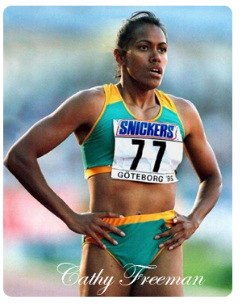
Cathy Freeman, an Australian with Aboriginal heritage who days earlier lit the cauldron to open the 2000 Sydney Olympics, won the 400 meters under a searing spotlight. She took a victory lap carrying the Australian and Aboriginal flags.

Slide 21
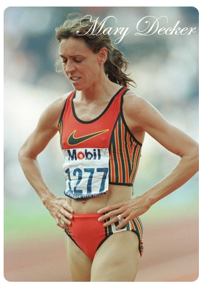
The USA's Mary Decker and Britian's Zola Budd collided in the 1984 final of the 3,000 meters, leaving pre-race favorite Decker with a pulled hip muscle, unable to get up and finish the race. Budd finished seventh. Debate ensued over whether Budd had cut inside without establishing a clear lead.

Slide 22
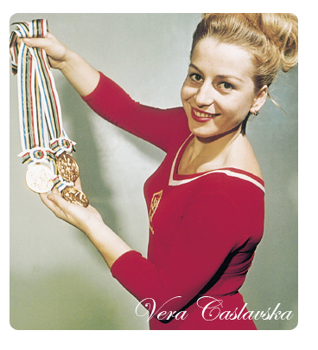
In the 1968 Summer Olympics, when standing on the gold medal podium with Soviet Union's Larissa Petrik, Vera Caslavska from Czechoslovakia put her head down while the Soviet Union anthem was playing to protest Soviet Union's invasion of Czechoslovakia.

Slide 23
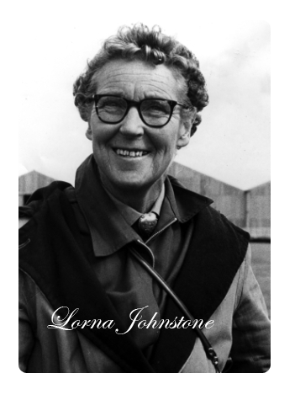
British Equestrian, Lorna Johnstone was 70 years and 5 days old when she rode at the 1972 Games, thus being the oldest woman ever to compete at an Olympic Games.

Slide 24
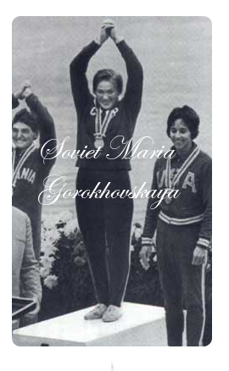
Unhindered by the limits set on female competitors at earlier Games - in 1952 sets a record for most medals won by a woman in one Olympics, with two golds and five silvers.

Slide 25
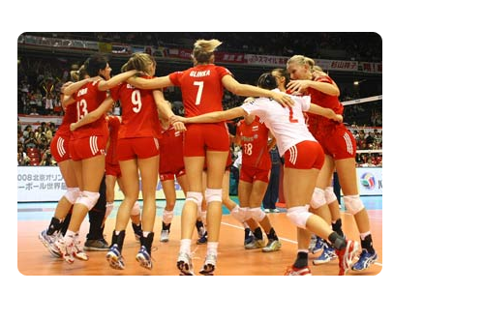
In conclusion, women are equal to men in every way. Women deserve respect. Women can make the history. Women matter.

Slide 26
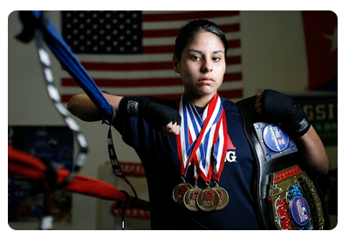
We can be as successful as men. We can achieve anything. We work as hard as everyone. Women at Olympic Games will never be forgotten, because of their persistence, diligence and dedication to sports.

Slide 27
Resources:
Images: Google Images
Biographies: Wikipedia
‘’Memorable moments’’ content: http://shareranks.com/
Graphics & comments: Aleksandra Szejnoga

